Slide 1

COMPUTER SCIENCE PROJECT
LIBRARY MANAGEMENT STSTEM
DONE BY:-
JAYACHANDRA B.
AMITH S KUMAR
P.SAI GANESH

Slide 2
CONTENT
REQUIREMENTS
GENERAL DESCRIPTION
MODULES USED
LOOK OF HOME PAGE
SPECIFI CATIONS
BIBLIOGRAPHY

Slide 3

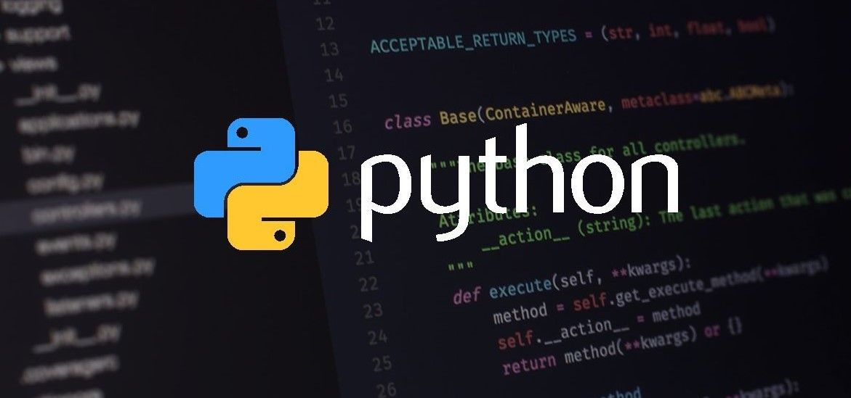
REQUIREMENTS
PYTHON(SOFTWARE)
MYSQL(SOFTWARE)
AND A LITTLE OF FROGRAMMING

Slide 4
GENERAL DESCRIPTON
A e-LIBRARY IS A VIRTUAL FORMOF STIRING BOOKS
IT IS HELPFUL IN EASILY ORGANISING DATA OF LIBRARY
IT MAKES IT EASY FOR LIBRARIAN AND STUDENTS TO ACCESSN BOOKS
IT WILL BE EASY FOR LIBRARIAN TO MONITER ISSUING AND RETURNING OF BOOKS
IT CLASSIFIES RETURNED BOOKS AND ISSUED BOOKS SEPARATELY
STATUS OF BOOK CAN BE KNOWN
ALLOWS TO ENTER NEW BOOKS WITH EASE

Slide 5
MODULES USED
Tkinter
PIL
pymysql

Slide 6
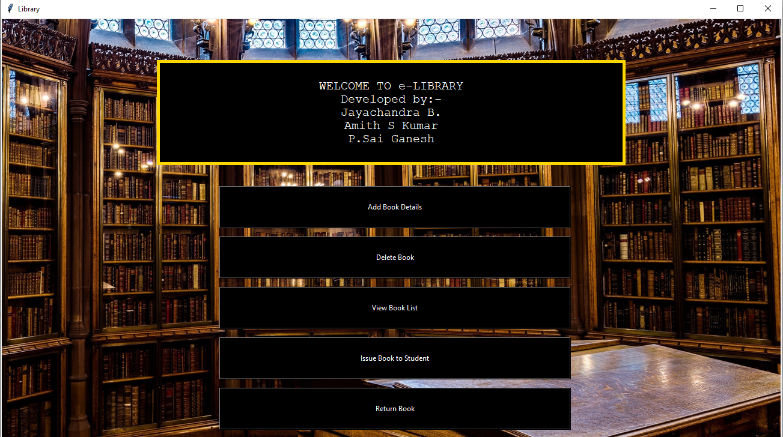
Look of the home page

Slide 7
specifications
ADD BOOK
DELETE BOOK
VIEW BOOK LIST
ISSUE BOOK
RETURN BOOK

Slide 8
BIBLIOGRAPHY
COMPUTER SCIENCE BOOK – SUMITA ARORA

Slide 9


